Slide 1
Digital Portfolio
STUDENT NAME: SATHIYA S
REGISTER NO : 24132161802522091
NMID:D656799F02D787AAD5943C7D59481666
DEPARTMENT: BSC . COMPUTER SCIENCE
COLLEGE: GOVERNMENT ARTS AND SCIENCE COLLEGE THIRUVENAINALLUR / ANNAMALAI UNIVERSITY

Slide 2
PROJECT TITLE
Digital Notepad:
An efficient and convenient digital notepad developed with core web technologies, providing essential note-taking features accessible from any device.

Slide 3


AGENDA
Problem Statement
Project Overview
End Users
Tools and Technologies
Portfolio design and Layout
Features and Functionality
Results and Screenshots
Conclusion
Github Link
3/21/2024 Annual Review

Slide 4

PROBLEM STATEMENT
Manual quiz processes are inefficient and prone to errors, requiring significant effort to administer and score.
Existing online quiz platforms lack good data management, user interactivity, and instant feedback for users.
The quiz app aims to provide a fast, user-friendly platform with automated scoring and performance tracking

Slide 5

PROJECT OVERVIEW
The quiz app is a web/mobile application developed to allow users to participate in quizzes on various topics.
Users select quiz categories, answer multiple-choice questions, and receive immediate results.
The project focuses on usability, accessibility, and interactive learning features

Slide 6

WHO ARE THE END USERS?
Students wishing to assess and improve their knowledge in different subjects.
Trivia enthusiasts who enjoy challenging themselves and competing with peers.
Teachers or coaches looking to conduct online assessments quickly and efficiently.

Slide 7

TOOLS AND TECHNIQUES
Frontend: Developed using HTML, CSS, JavaScript for responsive and interactive user interface.
Backend: Managed with a database (e.g., MySQL, Firebase) to store questions, scores, user profiles.
Utilizes APIs for authentication, score tracking, and real-time data communication.
Features timer, randomized question selection, and instant feedback mechanisms

Slide 8
POTFOLIO DESIGN AND LAYOUT
Clean, user-friendly interface for easy navigation and engagement.
Responsive layout compatible with both desktop and mobile devices.
Clear presentation of questions, answer choices, timers, and scoreboards
‹#›

Slide 9
FEATURES AND FUNCTIONALITY
User authentication and login system for personalized experience.
Diverse quiz categories with varying difficulty levels.
Timer for each quiz/question to increase challenge and fairness.
Instant feedback after each answer; summary and analysis at the end

Slide 10
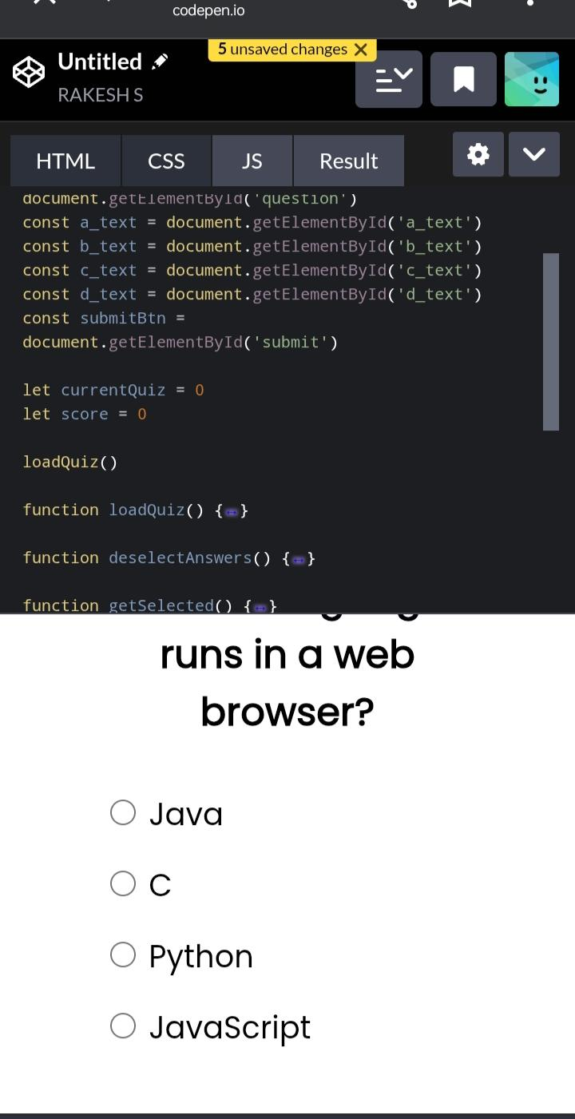

RESULTS AND SCREENSHOTS
Displayed score, correct answers, and performance summary after quiz completion.
Screenshot showing the quiz interface: question, answer options, timer, and result page.
Example of leaderboard or report chart for multiple users.
3/21/2024 Annual Review
‹#›

Slide 11
CONCLUSION
Quiz app simplifies the process of conducting assessments and enhances interactive learning.
Offers a scalable, real-time solution for users and educators.
Encourages knowledge sharing, self-evaluation, and healthy competition among users
‹#›

